Slide 1
Dissertation Update
Raul Unnithan

Slide 2
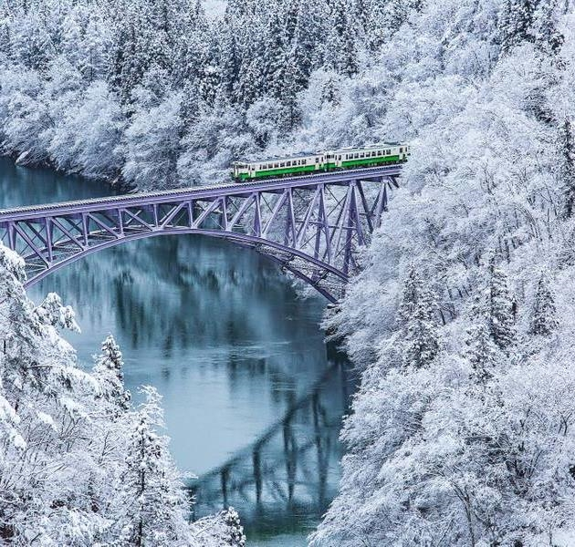
Agenda
Selection Methods
Shrinkage Methods
Random Forest
XGBoost
Neural Networks

Slide 3
Selection Methods
Single Response Regression -> MRR
Selection Methods -> how I coded them for MRR?
MANOVA for response intercorrelation (Wilks Lambda Test)
Extend to interaction and polynomial Terms
Evaluate all models produced with different features
All finished!

Slide 4
Shrinkage Methods
Done:
Lasso and Ridge in single response -> Multivariate Lasso and Ridge but they don’t consider intercorrelation
MRCE and RRRR are extensions of these methods + how they do consider response intercorrelation
TBD:
Finish-up methodology write-up for MRCE and RRRR
Practice more examples to truly understand MRCE – find conceptually difficult.

Slide 5
Random Forests
Done:
Defined them for single response
Finished Code
TBD:
Finish-up methodology write-up for MRF and CovRegRF

Slide 6
XGBoost
Done:
Made XGBoost model with covariance-aware loss function
TBD:
Write about the covariance loss function
Write-up my results for it

Slide 7
Neural Networks
Done:
Written an introduction to neural networks
Written code for the Multi-Ouput Gaussian Process NN
TBD:
Write up methodology for it

Slide 8
Questions
Is adjusting the loss function too easy for a level 4 project? – important to know before finishing writing all the theory for them

